Slide 1

PREDICTIVE ANALYTICS WITH ENSEMBLE LEARNING
TIM AJAR KECERDASAN ARTIFICIAL

Slide 2

Agenda
Introduction
decision trees classifier
Random forest

Slide 3
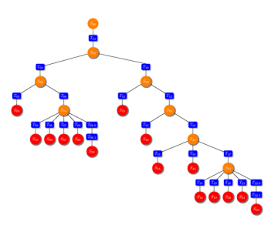
What are decision trees?
Decision trees are machine learning models that are in the form of tree structures.
A decision tree is a way to partition a dataset into distinct branches. The branches or partitions are then traversed to make simple decisions.
The decision process starts at the root node at the top of the tree. Each node in the tree is a decision rule. Algorithms construct these rules based on the relationship between the input data and the target labels in the training data. The values in the input data are utilized to estimate the value of the output.

Slide 4
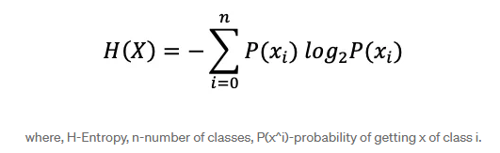
Entropy
Entropy
Entropy is a concept that stems from information theory, which measures the impurity of the sample values.
Entropy values can fall between 0 and 1. If all samples in data set, S, belong to one class, then entropy will equal zero. If half of the samples are classified as one class and the other half are in another class, entropy will be at its highest at 1
In order to select the best feature to split on and find the optimal decision tree, the attribute with the smallest amount of entropy should be used.

Slide 5
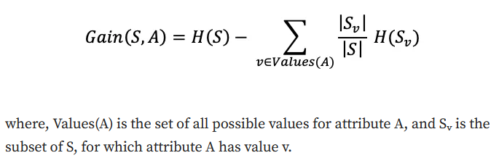
Information gain
Information gain represents the difference in entropy before and after a split on a given attribute. The attribute with the highest information gain will produce the best split as it’s doing the best job at classifying the training data according to its target classification.

Slide 6
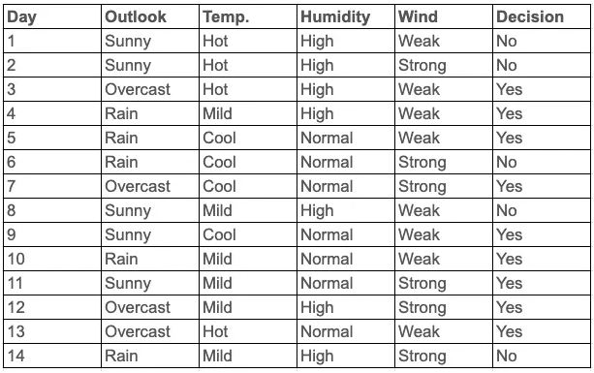
Let’s walk through an example to solidify these concepts. Imagine that we have the following arbitrary dataset:
Questions: how to decide which attribute forms the root node? Ans: The attribute which has the highest Information Gain is to be chosen as the root node, Because the higher the Information gain value the better it classifies the training data.

Slide 7
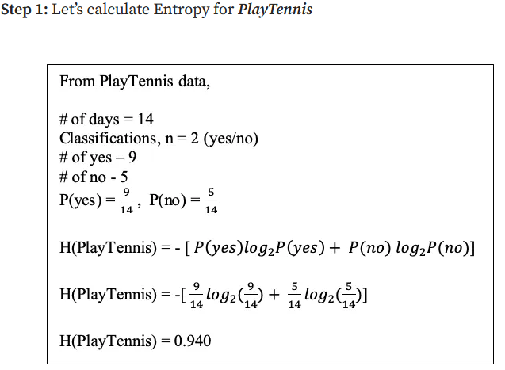
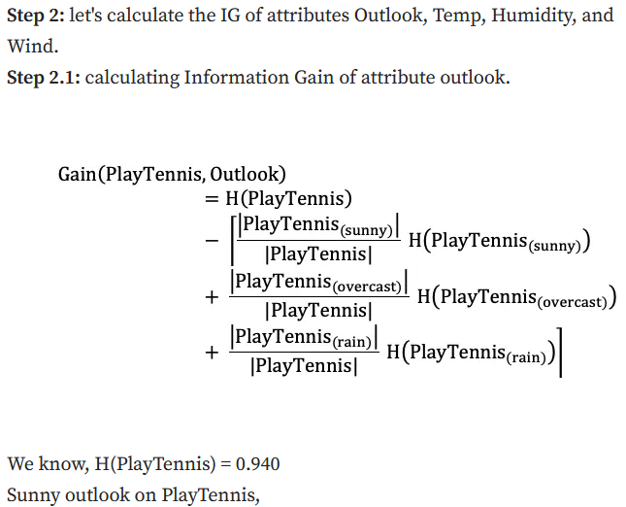

Slide 8
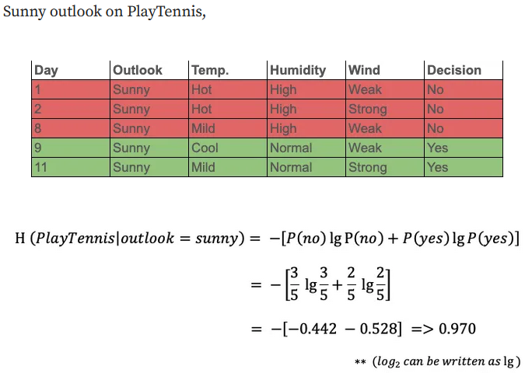


Slide 9
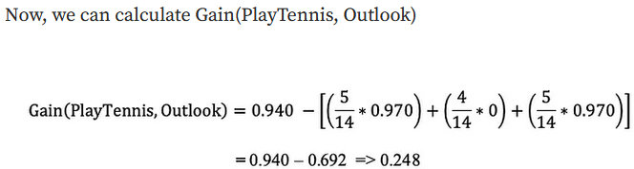
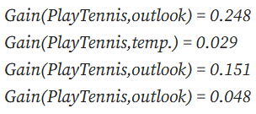
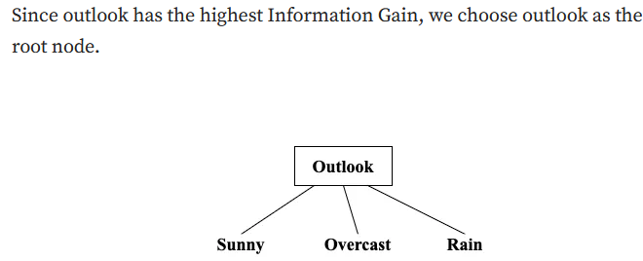

Slide 10
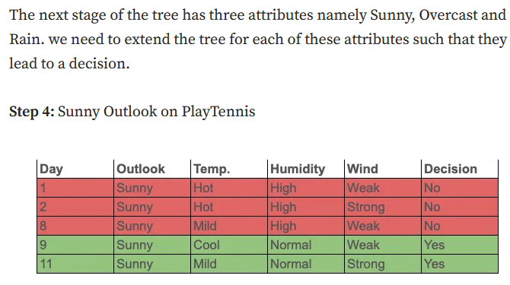



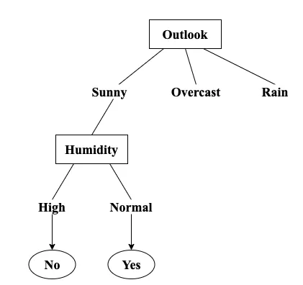
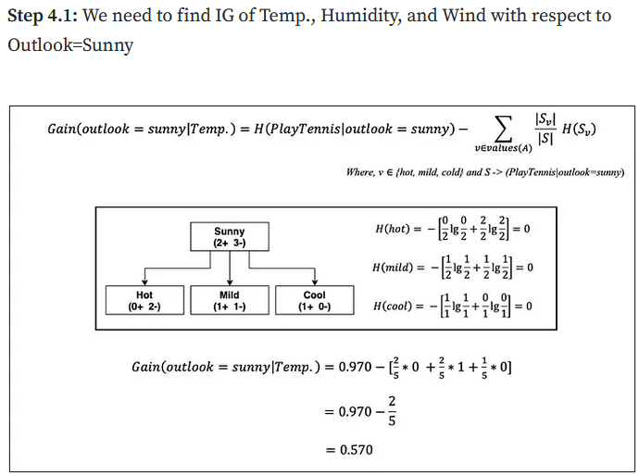

Slide 11
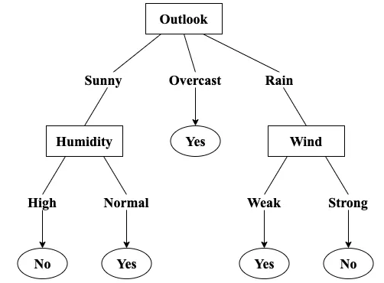
Example: decision tree
https://medium.com/@sudhakar.rulz/decision-tree-for-beginners-7cdc319c1470

Slide 12
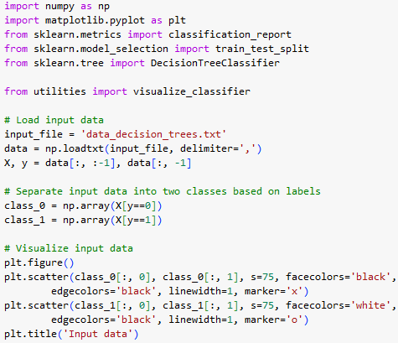
Building a decision tree classifier
- Download resource (utility.py dan data_decision_trees.txt)
- Open google colab

Slide 13
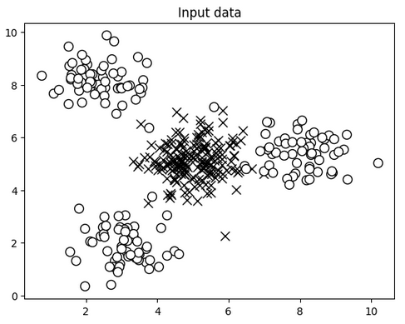
Building a decision tree classifier
- Download resource (utility.py dan data_decision_trees.txt)
- Open google colab

Slide 14
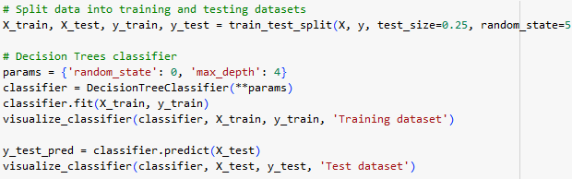
Building a decision tree classifier

Slide 15
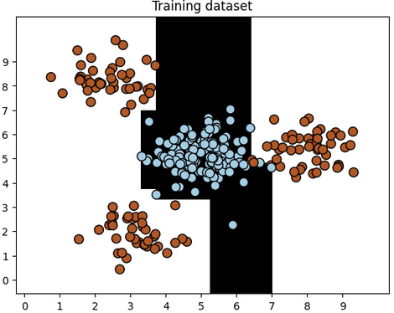
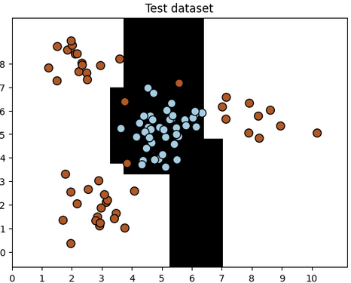
Building a decision tree classifier

Slide 16
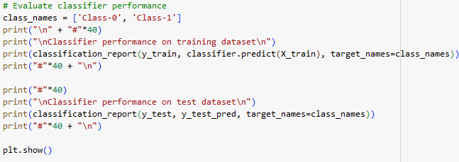
Building a decision tree classifier

Slide 17
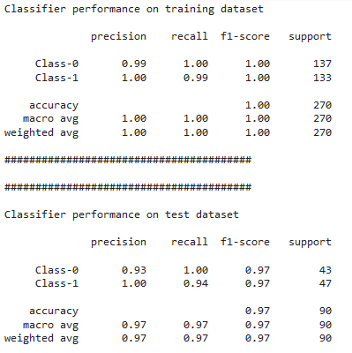
Building a decision tree classifier

Slide 18
Ensemble learning
Ensemble learning, in general, is a model that makes predictions based on a number of different models. By combining individual models, the ensemble model tends to be more flexible (less bias) and less data-sensitive (less variance).
There are two types of Ensemble Method:
Bagging: Training a bunch of individual models in a parallel way. Each model is trained by a random subset of the data
Boosting: Training a bunch of individual models in a sequential way. Each individual model learns from mistakes made by the previous model

Slide 19
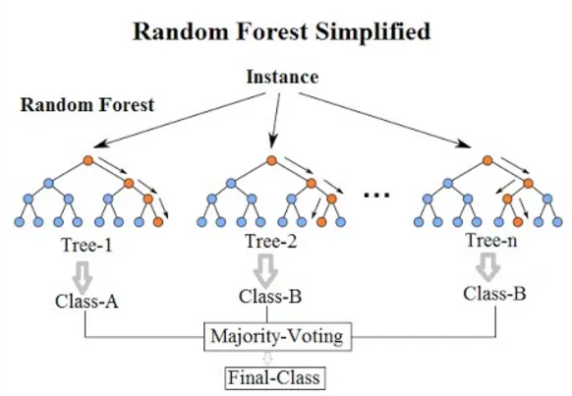
RANDOM FOREST?
A random forest is an instance of ensemble learning where individual models are constructed using decision trees.
Random forests combines the output of multiple decision trees to reach a single result.

Slide 20
How it works
Random forest algorithms have three main hyperparameters includes include node size, the number of trees, and the number of features sampled which need to be set before training. The random forest classifier can be used to solve for regression or classification problems.
The random forest algorithm is made up of a collection of decision trees, and each tree in the ensemble is comprised of a data sample drawn from a training set with replacement, called the bootstrap sample. Of that training sample, one-third of it is set aside as test data
Another instance of randomness is then injected through feature bagging, adding more diversity to the dataset and reducing the correlation among decision trees. Depending on the type of problem, the determination of the prediction will vary.
For a regression task, the individual decision trees will be averaged, and for a classification task, a majority vote—i.e. the most frequent categorical variable—will yield the predicted class.

Slide 21


Thank you

